Slide 1
Formula For Success – Best Director, Actor/Actress, and Producer
BY: Carlos Marin

Slide 2
Outline
Background
Business Problem
Data
Methods
Results
Conclusions

Slide 3

Background
Every Year, different movies of different genres are released every year. While there are different measures for success, I rate a directors, actors, and producers' success on two things the return on investment and the average rating of their films.

Slide 4
Business Problem
What is the formula for success? A good director, producer, and the right actors. A good movie has the right actors/actresses, directors, and producers. People are more likely if a certain individual is tied to a new movie. I provide insight on best people who are very successful in the role.

Slide 5
Data
Using six different data sets from sources such as IMDB and TheNumbers.
Provide descriptive statistics on ROI Percentage and average rating.
Individuals are grouped, allows analysis for individual rather than movie
ROI Percentage and average rating plotted.

Slide 6
Methods
First create separate data frames by role
Identify top individuals by value counts
Group by individuals – then plotted both Return on Investment Percentage (ROI Percentage) and average rating.

Slide 7
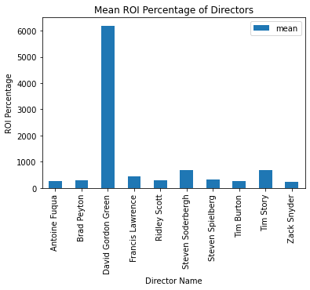
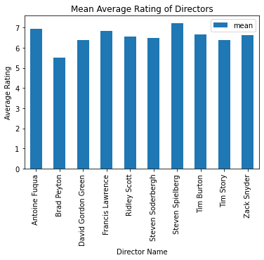
Results - Directors

Slide 8
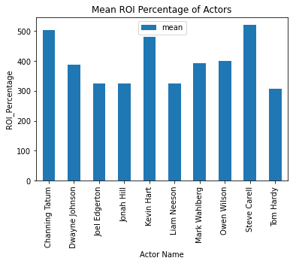
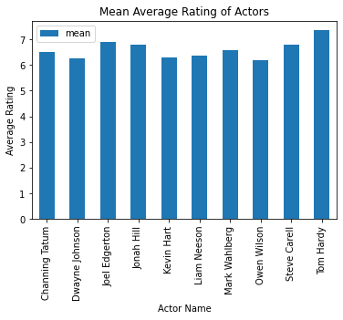
Results - Actors

Slide 9
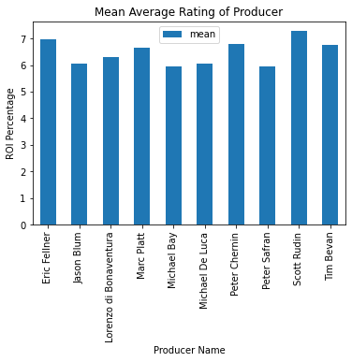
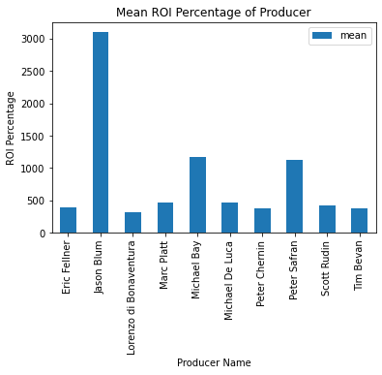
Results - Producers

Slide 10
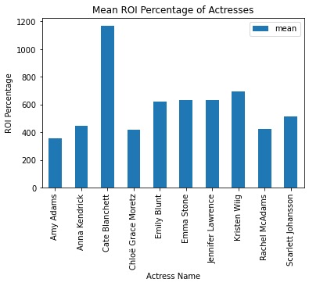
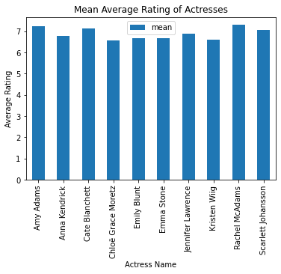
Results - Actresses

Slide 11

Results (continued…)
Results show there is little variability on average rating. The biggest measure of success is by ROI Percentage.

Slide 12
Conclusions/ Findings
-1) David Gordon Green is the highest ROI director, His success in movies vary from dark comedies movies like Pineapple Express and shows like "Eastbound and Down' to slasher films such as Halloween he has great variety under his belt.
-2) Top 3 Actors are Channing Tatum, Kevin Hart, and Steve Carell. Kevin Hart and Steve Carell are largely known for their comedies. Channing Tatum is a bit of wildcard he has played in action movies such as White House Down, and GI Joe, he has also played in comedies such as 21/22 Jump Street Films and Dramas such as Dear John and Coach Carter.
-3) Jason Blum, he is the best Producer for thrillers and horrors. He is well known for his work in movies such as paranormal activity, Halloween, The Purge. He worked with David Gordon Green for the Halloween movies.
-4) Cate Blanchett, is another jack of all trades for an actress. She has played Dramas such as the Curious Case of Benjamin Button, to Comedies like Don't Look Up, and Fantasy like The Hobbit/Lord of the Rings.

Slide 13
Next Steps…
-1) Provide Genre Specific data. For Example, best Action Director, Action Producer, Action Actors and Actresses.
-2) Does Streaming vs Box Office affect movie success.. we live in a time where movies are now released via streaming platforms. Compare success of movies released via streaming platforms independently from box office.
-3) Include different measure of success... i.e., popularity. How often is this movie viewed? or Box Office success on a week-by-week basis is another measure of popularity.

Slide 14

Thank you!

